Slide 1
JavaScript for test engineers
Module #2 – Functions
Starting at 11:05 CET

Slide 2

Modules
1
JavaScript basics
2
Functions
3
OO, classes
4
Array, String
5
JSON, Promise, RegExp

Slide 3

Functions
Module #2

Slide 4
Agenda
1
functions
2
scopes
3
Arrow functions
4
Self-invoking functions
5
callback

Slide 5
Agenda
6
Describe-it test definition
7
Mocha, Jasmine
8
Writing tests

Slide 6
Functions

Slide 7
What is a function?
Functions are one of the fundamental building blocks in JavaScript.
A function is a JavaScript procedure — a set of statements that performs a task or calculates a value.
In JavaScript, functions are first-class objects, because they can have properties and methods just like any other object. What distinguishes them from other objects is that functions can be called. In brief, they are Function objects.

Slide 8


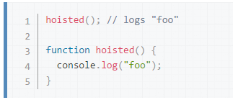
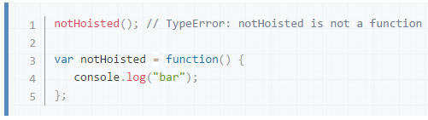
How to create a function?
Function declaration
Function expression
IIFE – Self-invoking
Arrow functions
Hoisting

Slide 9

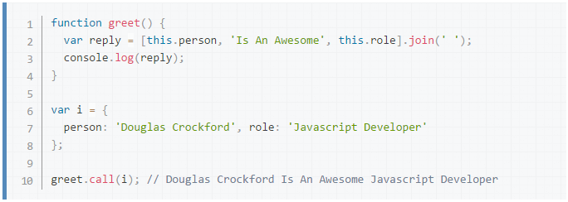
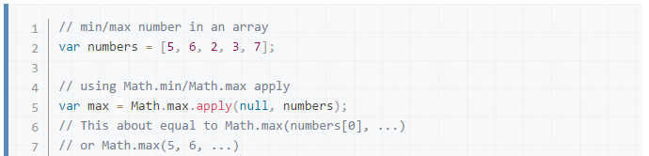
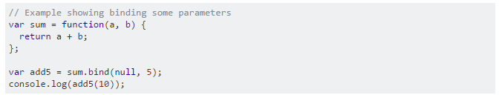
How to call a function?
With parenthesis: myFunction(42)
call, apply, bind
Returns a value, always!

Slide 10
Arguments
No types, as usual
Primitives passed by value, objects by reference
Bind by order
Unset arguments are undefined

Slide 11
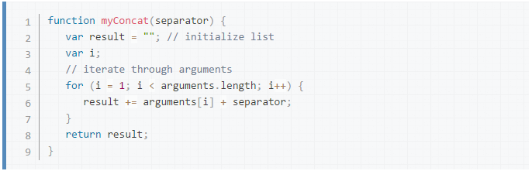
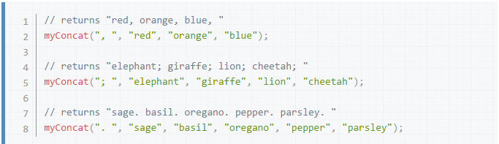
Arguments object
Contains the current arguments as an Array.
Bound in order
We can make functions with not strict argument list

Slide 12
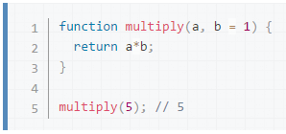
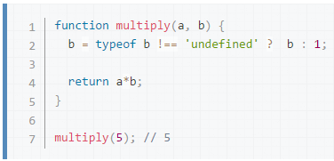
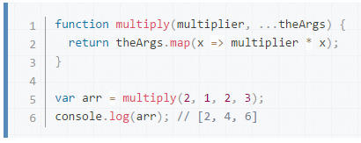
Default parameters, rest parameter
Default parameters (ES6): have default value if not set
Rest parameters (ES6): indefinite number of arguments

Slide 13
SCOPES

Slide 14
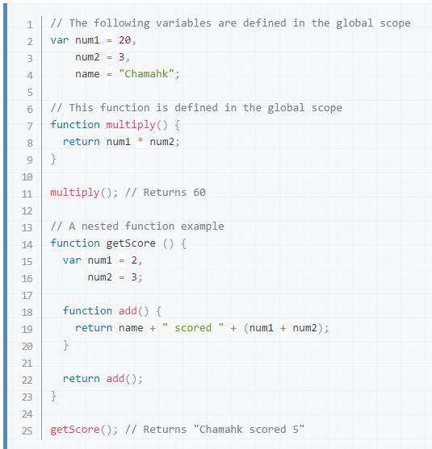
Function scope
Variables defined inside a function cannot be accessed from anywhere outside the function, because the variable is defined only in the scope of the function.
However, a function can access all variables and functions defined inside the scope in which it is defined.
Global scope: window, global

Slide 15
Block scope
ES5: no real block scope (have workaround)
ES6: with let and const
var c = 1;
{
var c = 2;
}
console.log(c); // 2
let c = 1;
{
let c = 2;
}
console.log(c); // 1
var c = 1;
(function () {
var c = 2;
})();
console.log(c); // 1

Slide 16
Block scope
Scopes vs Loops
for (var i = 0; i < 5; i++) {
setTimeout(function () {
console.log(i);
}, 0);
}
// 5 5 5 5 5
for (let i = 0; i < 5; i++) {
setTimeout(function () {
console.log(i);
}, 0);
}
// 0 1 2 3 4

Slide 17

5
minutes break

Slide 18
Arrow functions

Slide 19
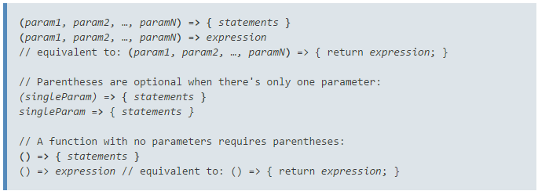
Arrow functions
An arrow function expression has a shorter syntax than a function expression.
It does not bind its own this, arguments.
Always anonymous.

Slide 20
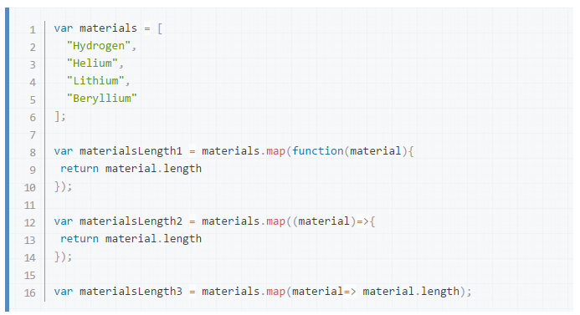
Arrow functions – Shorter syntax

Slide 21
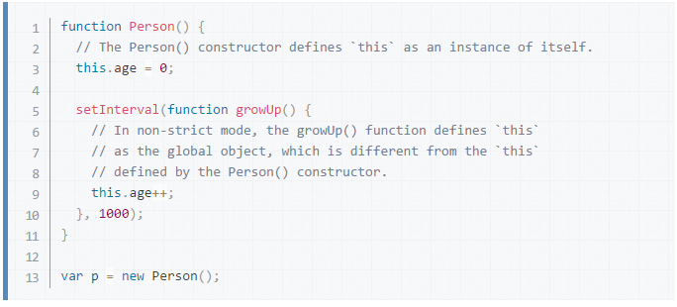
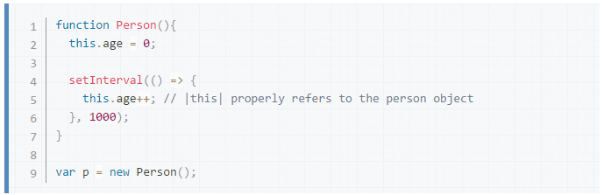
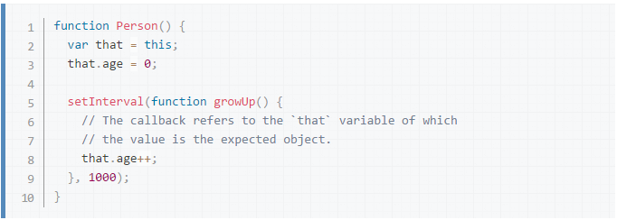
Arrow functions – No binding of this

Slide 22
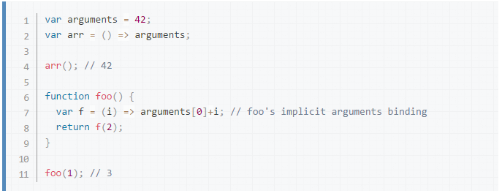
Arrow functions – No binding of arguments

Slide 23
Self-invoking functions

Slide 24

Self-invoking functions - IIFE
IIFE are function expression that are invoked as soon as the function is declared.
const result = (function fn(fn) {
return fn();
})(function () {
return 2;
});
// ?

Slide 25
callback

Slide 26
Callback
Function can be passed as arguments
const fnToExecute = function () {
console.log(’done’);
};
setTimeout(fnToExecute, 100);
function doOp(operation, op1, op2) {
return operation(op1, op2);
}
const add = function (a, b) { return a + b; }
const minus = (a, b) => a – b;
const multiply = (a, b) => a * b;
console.log(doOp(add, 1, 2)); // 3
console.log(doOp(minus, 5, 10)); // -15
console.log(doOp(multiply, 1, 11)); // 11

Slide 27
Describe-it

Slide 28
Describe-it
Test case: an atomic test
Test suite: group of Test cases or Test suites
Describe: function to define a test suite describe(nameString, definitionFn)
It: function to define a test case it(testSting, definitionFn)

Slide 29
Sample
describe(”Login”, () => { it(”should work with correct credentials”, () => { // some code which logs in with correct credentials }); it(”should show error in case of incorrect credentials”, () => { // some code which tries to login with correct credentials // and then checks the visibility of the error message }); });

Slide 30
Mocha, Jasmine

Slide 31

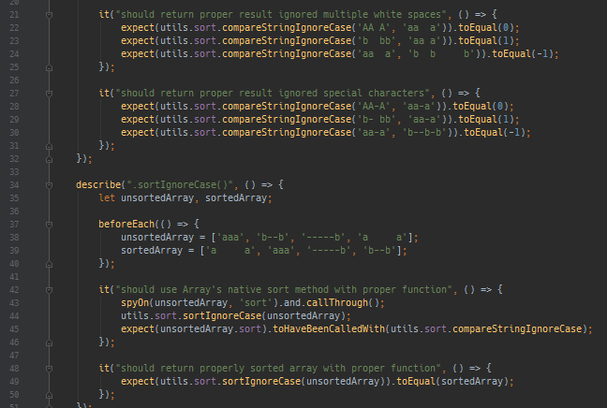
Jasmine
Test execution framework
Suite: describe
Test case: it
Hooks: beforeEach, afterEach, beforeAll, afterAll
Assertion: expect
Test doubles: spyOn
Development: pending, fdescribe, fit, xdescribe, xit
Sync, but handles async with callbacks.
http://jasmine.github.io/

Slide 32

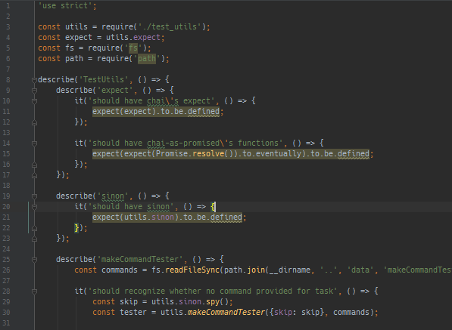
Mocha
Test execution framework
Suite: describe
Test case: it
Hooks: beforeEach, afterEach, before, after
Assertion: -
Test doubles: -
Development: (describe|it).(skip|only)
Sync + Async (Promise, Callback)
http://mochajs.org

Slide 33
Writing tests

Slide 34
Write unit tests
Create unit tests for the calculator module.
Write test suites and test cases (pending)
Created test case definitions
calc(3).v // 3 calc(3).add(5).v // 8 calc(3).minus(2).v // 1 calc(4).sqrt().v // 2 calc(3).times(10).v // 30 calc(10).divide(2).v // 5 calc(10).mod(5).v // 0 calc(5).divide(0) // throw error calc(3).add(4) .minus(3) .times(6).v // 24

Slide 35
Questions?

Slide 36
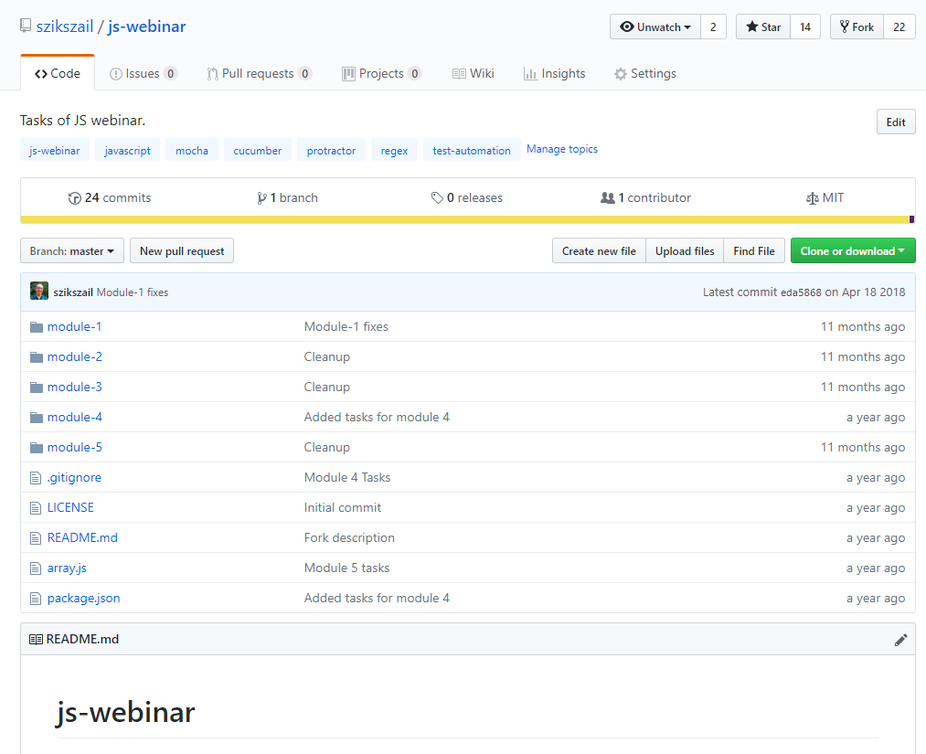
„Tasks”
To practice, NOT mandatory!
https://github.com/szikszail/js-webinar
All instructions in the README, including Tasks and Task review guidelines
To practice: https://www.hackerrank.com/dashboard

Slide 37
Thank you for your attention!

